Slide 1


Miracle of Luck
Lottery web application
Mahmoud Kraiem & Alexander Danilov
Supervisor: Dr.Zakharia Frenkel

Slide 2







Plan
Intro
Solution
Architecture
Challenges
Software Documentation
GUI
Tests

Slide 3

Introduction
Our web application simplifies the lottery experience with its user-friendly environment. Users can easily participate in and create lotteries in any way they want, including for fundraising, giveaways, or like-and-share lotteries. With seamless integration of social media features, users can easily share their favorite lotteries and engage with the community.

Slide 4

The are 3 main problems in current lottery web applications:
Too Complicated.
Cannot Create lotteries like and shere.
Cannot Do All This on One Web application.

Slide 5
Plan
Intro
Solution
Architecture
Challenges
Software Documentation
GUI
Tests

Slide 6
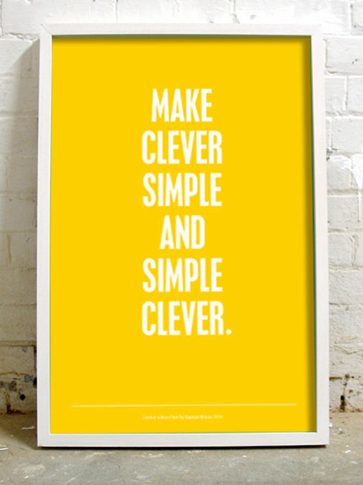
1.Too Complicated:
Our web application features a clean, intuitive layout with clear labels and an easy-to-follow menu structure. Designed for user-friendliness, it includes larger buttons, clear fonts, and logical content groupings, along with a guided tour for new users. We also minimize steps for common tasks like purchasing lottery tickets or checking results to enhance efficiency and ease of use.

Slide 7

2.Cannot Create Like and Share Lotteries:
Social Media Integration: We add social media buttons to allow users to share their lottery entries or winnings directly on platforms like Facebook.
Create Lotteries: We implement a feature that allows users to create and host their own lotteries. This can include customizable options like type of lottery, draw dates, and prizes.

Slide 8
3. Cannot Do All This on One Web application:
All-in-One Platform: We integrate all necessary functionalities into a single web application. We ensure that users can buy tickets, check results, and participate in lotteries without needing to visit multiple web applications.
Responsive Design: We will ensure the web application is responsive and works well on all devices (desktops, tablets, smartphones) .

Slide 9
Plan
Intro
Solution
Architecture
Challenges
Software Documentation
GUI
Tests

Slide 10



Architecture
1. Frontend (User Interface):
- Technologies: React.js, CSS
- Function: Displaying the website, allowing user interaction
2. Backend :
- Technologies: Node.js (JavaScript),Express.js
- Function: Handling business logic, API, and database interactions

Slide 11

Architecture
3. Database:
- Technologies: MongoDB (NoSQL)
- Function: Storing user data, lottery information, and transaction details
4. Security:
- Methods: HTTPS, JWT, Authentication & Authorization
- Function: Ensuring data transmission security and user data protection

Slide 12
Plan
Intro
Solution
Architecture
Challenges
Software Documentation
GUI
Tests

Slide 13
Problem we faced
1. Responsive Design:
Designing a responsive layout that looked appealing and worked effectively on all devices was a challenging task.
2. Deploy the website:
Deploying the website to run on the cloud was a difficult aspect of the project.
3. Image Handling:
Managing and displaying images for each lottery was challenging, particularly with respect to storage and optimizing loading times.
4. Search:
Developing an efficient search feature capable of handling a large number of lotteries and providing accurate result proved to be a challenge.

Slide 14
Plan
Intro
Solution
Architecture
Challenges
Software Documentation
GUI
Tests

Slide 15
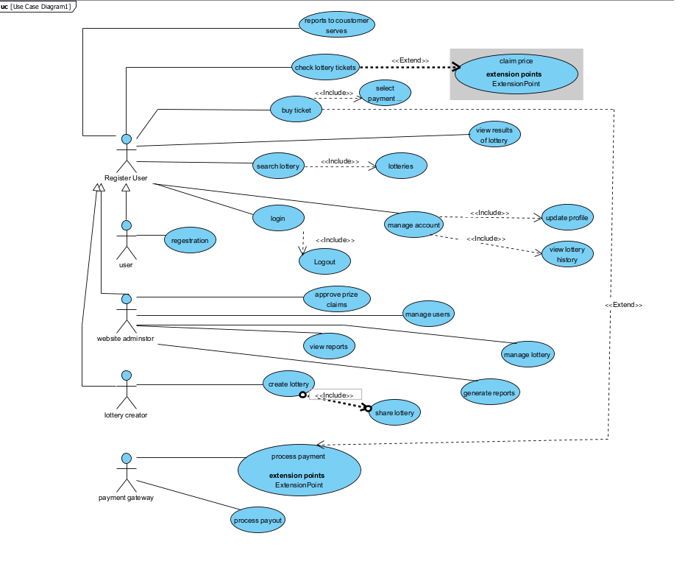
Use Case

Slide 16
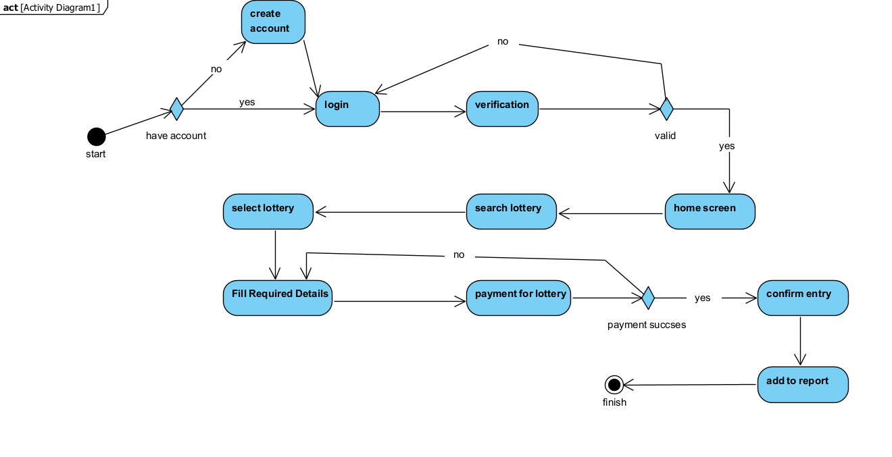
Activity Diagram

Slide 17
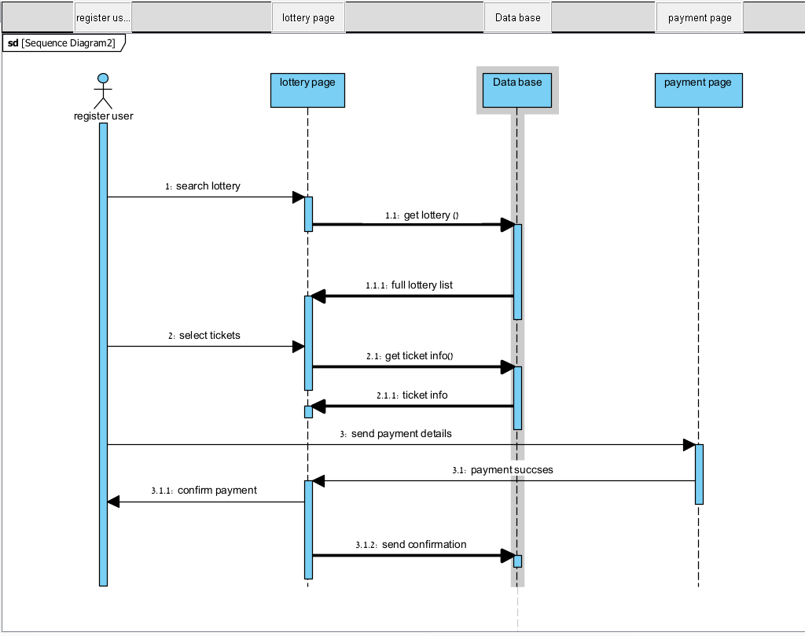
Sequence Diagram

Slide 18
Plan
Intro
Solution
Architecture
Challenges
Software Documentation
GUI
Tests

Slide 19
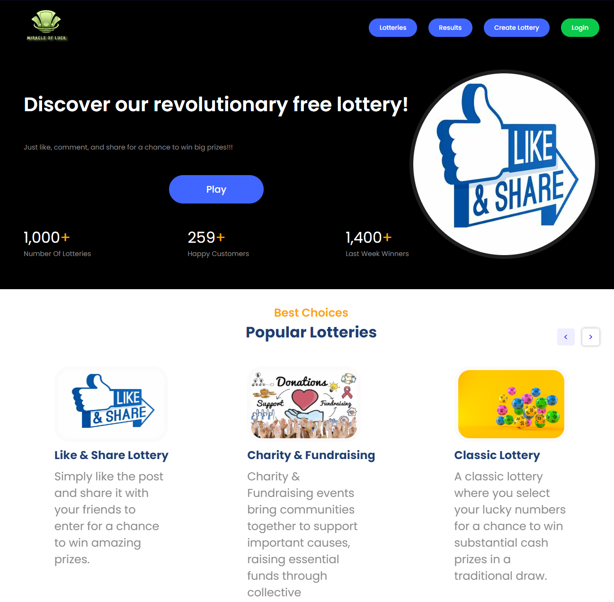
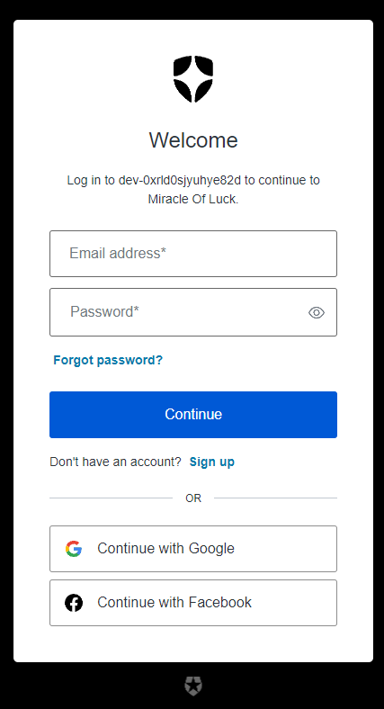
Main Page
Create Account Page

Slide 20
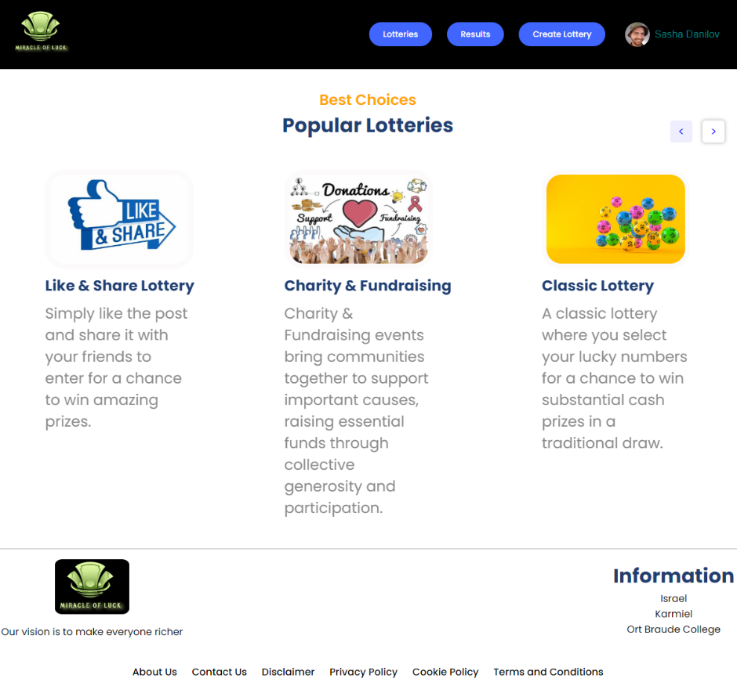
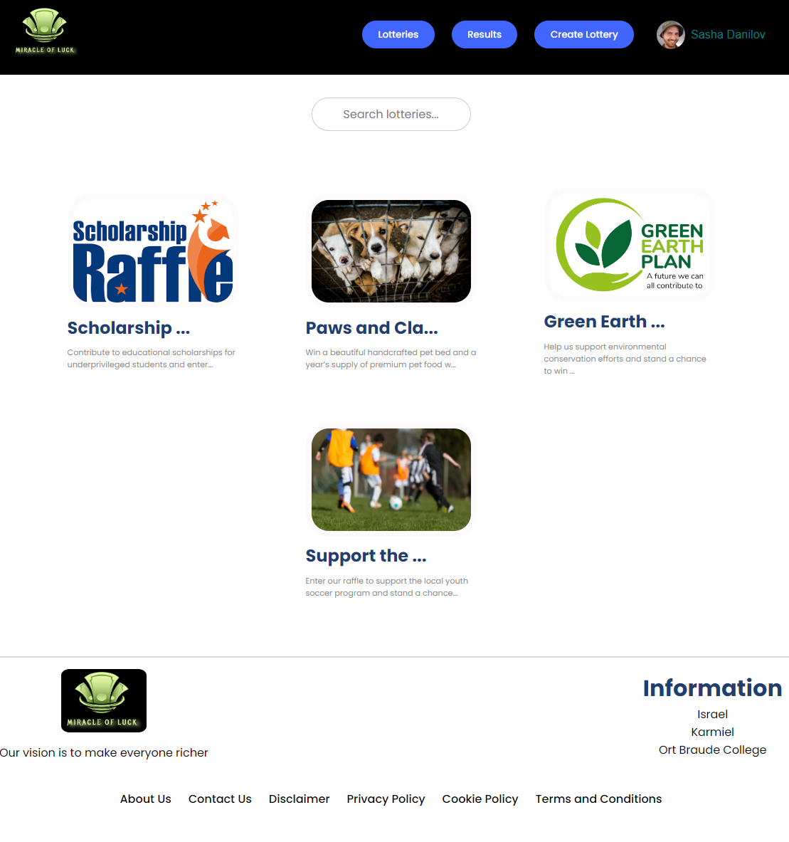
Lottery Page
Fundraising Page

Slide 21
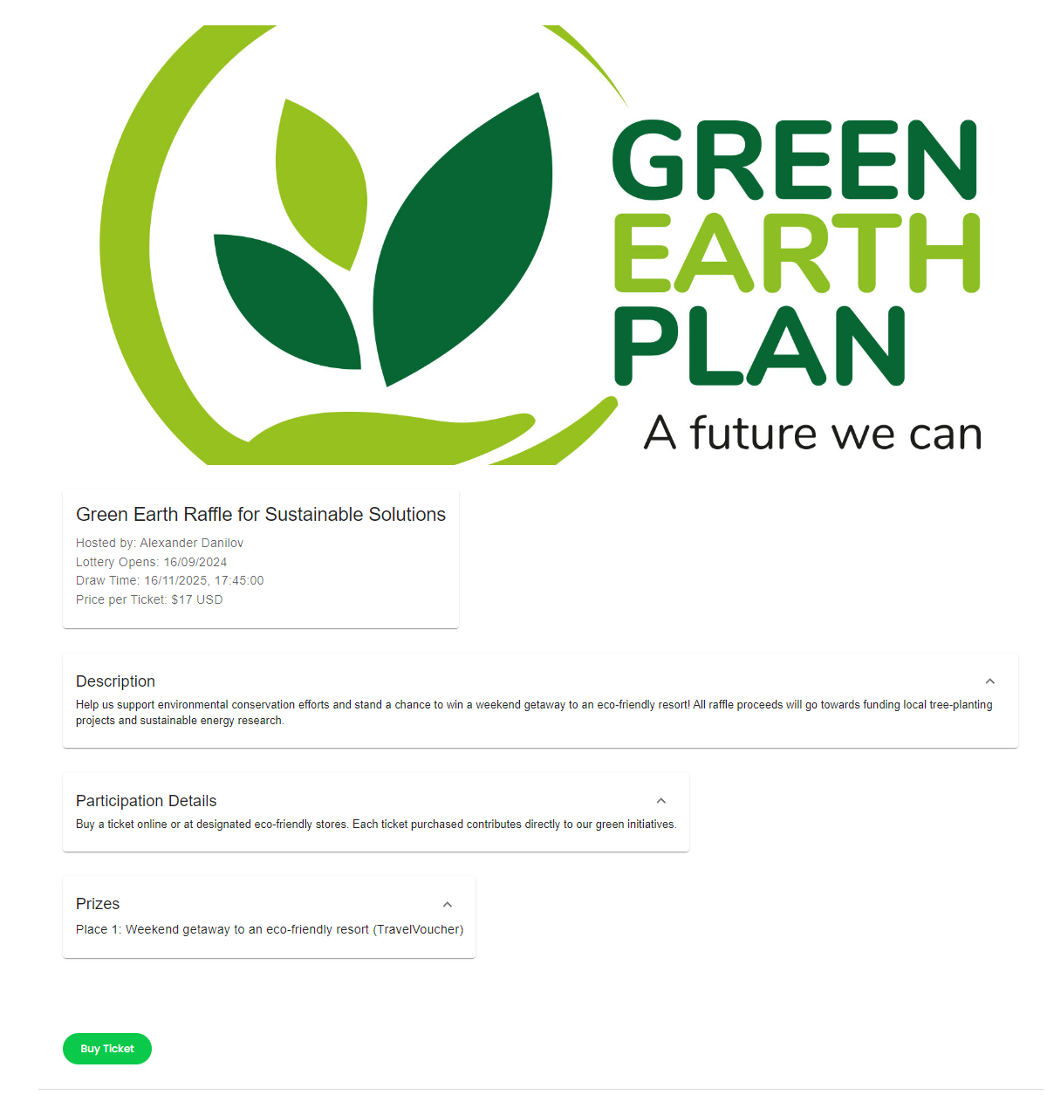
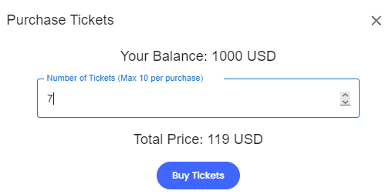
Details on Fundraising Lottery
Purchase Window

Slide 22
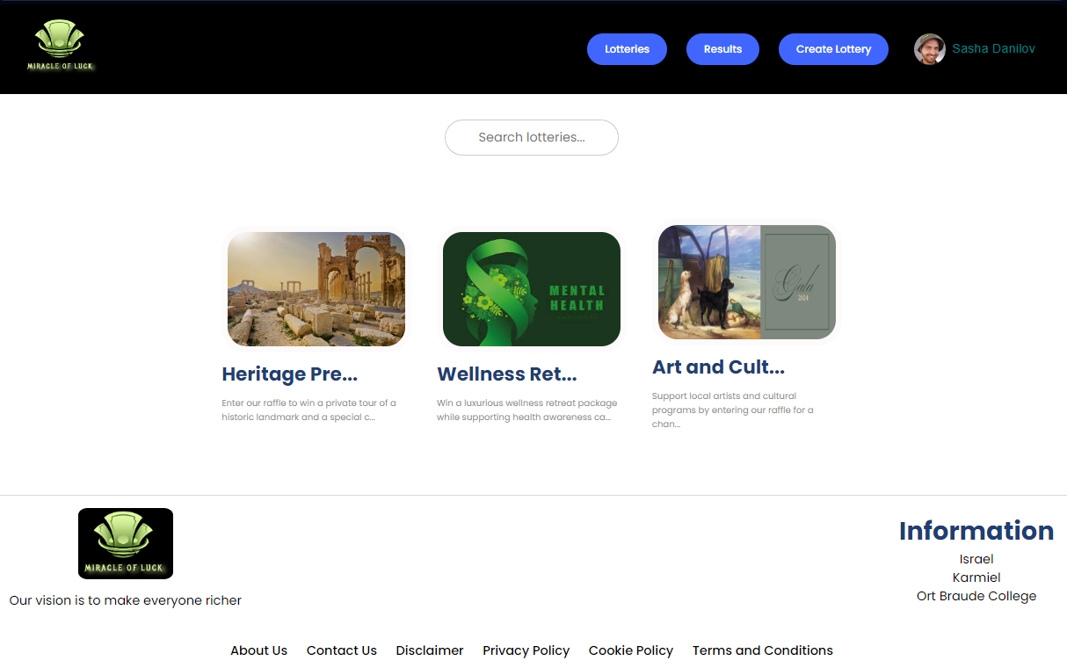
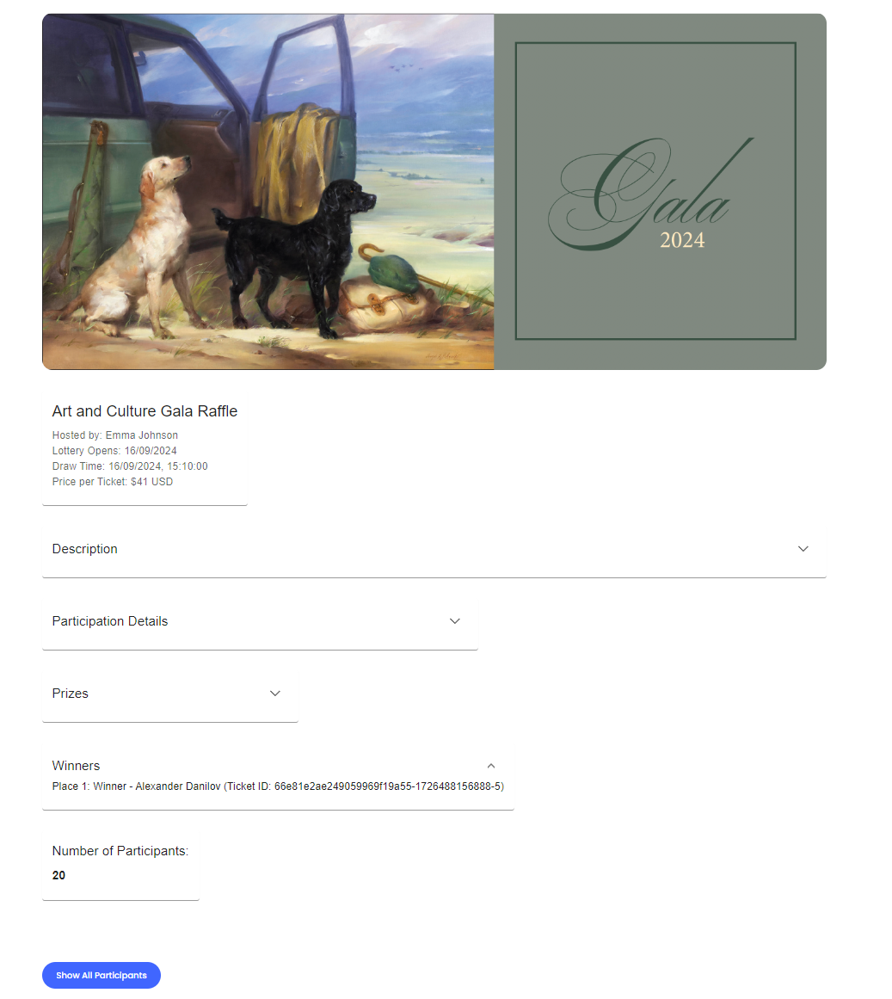
Results Page of Fundraising Page
Detailed Results of Art And Cult.. Lottery

Slide 23
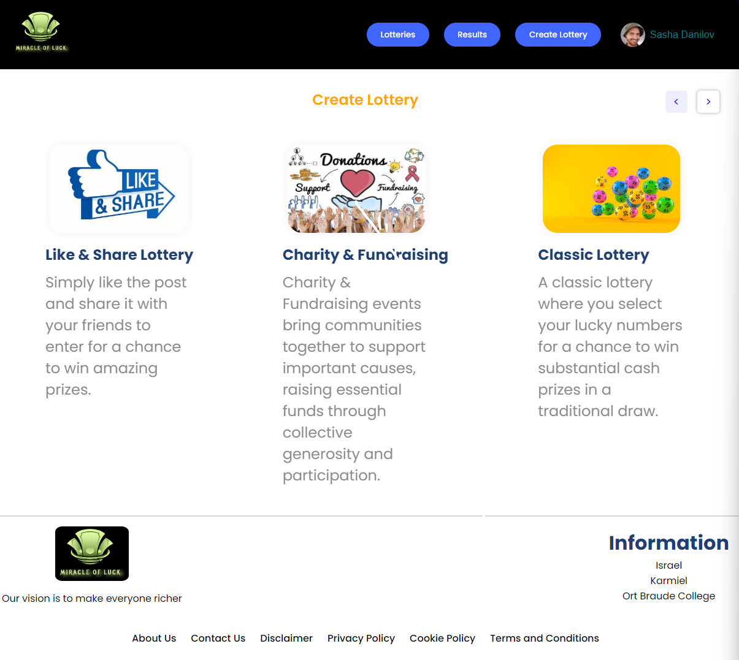
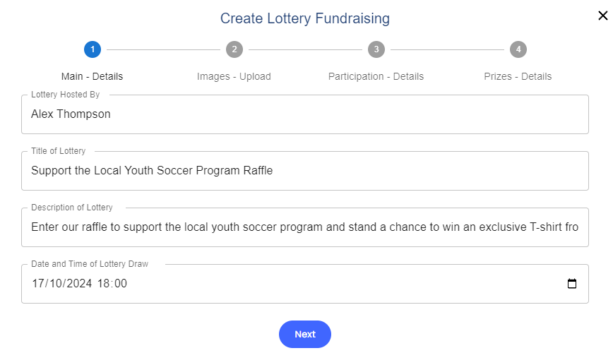
Create Fundraising Lottery Window
Create Lottery Page

Slide 24
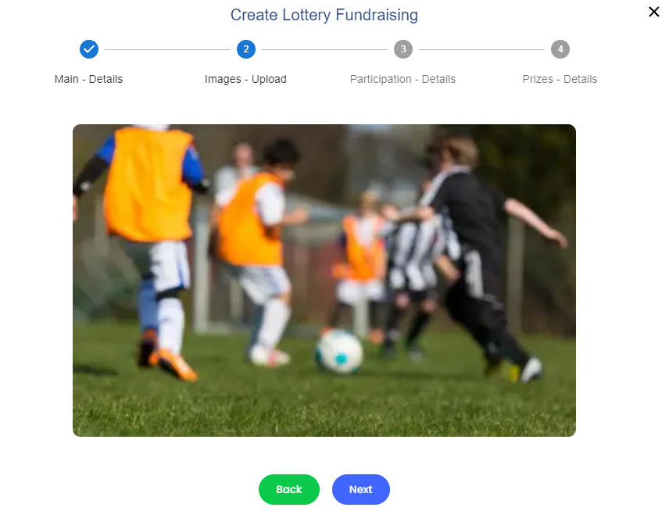
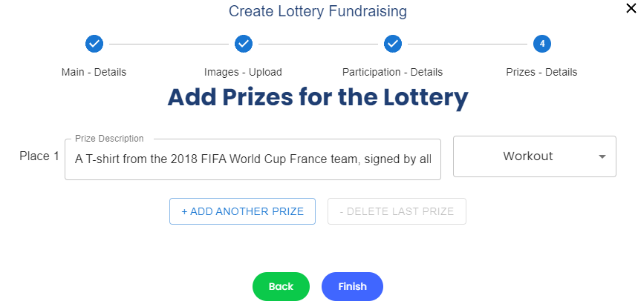
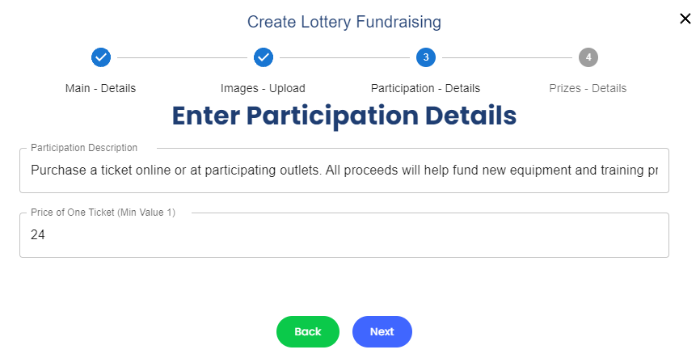

Slide 25
Plan
Intro
Solution
Architecture
Challenges
Software Documentation
GUI
Tests

Slide 26
Login Tests
Test Name | Description | Expected Results | Actual Results | Comments
Signing up with valid information. | Verify the ability to create a new account with valid information. | The user should be successfully registered and redirected to the login page with a confirmation message. | Successful registration and redirected to the login page after showing the message “Signing success “. | The user successfully registered and redirected to the login page with confirmation.
Signing up with an existing email. | Verify the handling of attempting to sign up with an email that is already registered. | The user should receive an error message indicating that the email is already in use and remains on the registration page. | Shown message to user “Email already in use “and stay on this page. | The user received an error message and remained on the registration page.
Signing up with a weak password. | Verify the handling of attempting to sign up with a weak password. | The user should receive an error message indicating that the password is too weak and remains on the registration page. | Shown a message to the user “Weak password “and stay on this page. | The user received an error message and remained on the registration page.
Signing up with an invalid email format. | Verify the handling of attempting to sign up with an invalid email format. | The user should receive an error message indicating that the email format is invalid and remains on the registration page. | Shown message to the user “Invalid email “and stay on this page. | The user received an error message and remained on the registration page.

Slide 27
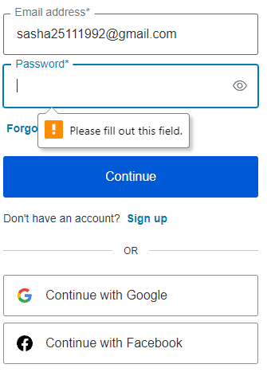
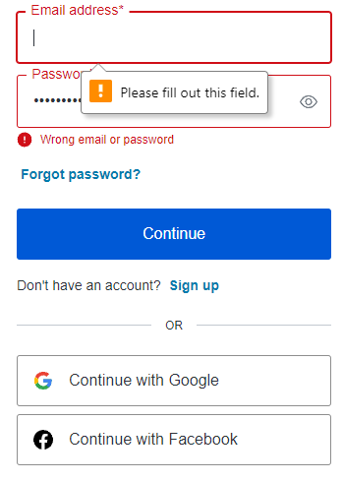
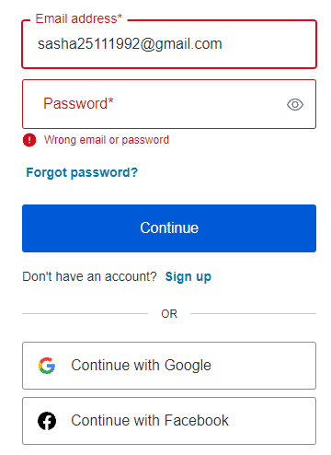


Slide 28
Purchasing Ticket Tests
Test Name | Description | Expected Results | Actual Results | Comments
Purchasing a ticket for an active lottery. | Verify the ability to purchase a ticket for an active lottery. | The user should be able to select a lottery, choose the number of tickets, make payment, and receive a confirmation message with ticket details. | Shown message to the user” Successful purchase”. | The ticket was successfully purchased. Confirmation message received.
Purchasing a ticket for an inactive or non-existent lottery. | Verify the handling of attempting to purchase a ticket for an inactive or non-existent lottery. | The user should receive an error message indicating that the lottery is not available for ticket purchase. | Shown message to use “Inactive or non-existent lottery “and stay on this page. | The user received an error message indicating lottery status.
Purchasing a ticket with insufficient funds. | Verify the handling of attempting to purchase a ticket without sufficient funds. | The user should receive an error message indicating insufficient funds and be prompted to add funds to their account. | Shown message to use “Insufficient funds “and stay on this page. | The user received an error message and instructions to add funds.
Purchasing multiple tickets simultaneously. | Verify the ability to purchase multiple tickets in a single transaction. | The user should be able to select multiple tickets, make payment once, and receive confirmation for all tickets purchased. | Shown user message” Successful multiple ticket purchase”. | Multiple tickets were purchased successfully in a single transaction.

Slide 29
Creating Lottery Tests
Test Name | Description | Expected Results | Actual Results | Comments
Creating a lottery with valid information. | Verify the ability to create a new lottery with valid details. | The user should be able to successfully create the lottery and see it listed on the website. | Shown message to the user” Successful creation”. | Lottery successfully created and listed on the website.
Creating a lottery with missing information. | Verify the handling of attempting to create a lottery with missing required fields. | The user should receive an error message indicating the missing information and remain on the creation form. | Shown message to the user “Missing information “and stay on this page | The user received an error message and remained on the creation form.
Creating a lottery with a past end date. | Verify the handling of attempting to create a lottery with an end date in the past. | The user should receive an error message indicating that the end date must be in the future and remain on the creation form. | Shown message to the user “Past end date “and stay on this page. | The user received an error message and remained on the creation form.
Creating a duplicate lottery. | Verify the handling of attempting to create a lottery with the same name as an existing one. | The user should receive an error message indicating that a lottery with the same name already exists and remains on the creation form. | Shown message to use “Duplicate lottery “and stay on this page. | The user received an error message and remained on the creation form.

Slide 30
Thank you all for your time and attention .

